Slide 1

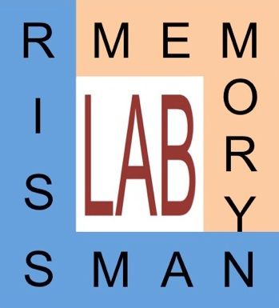

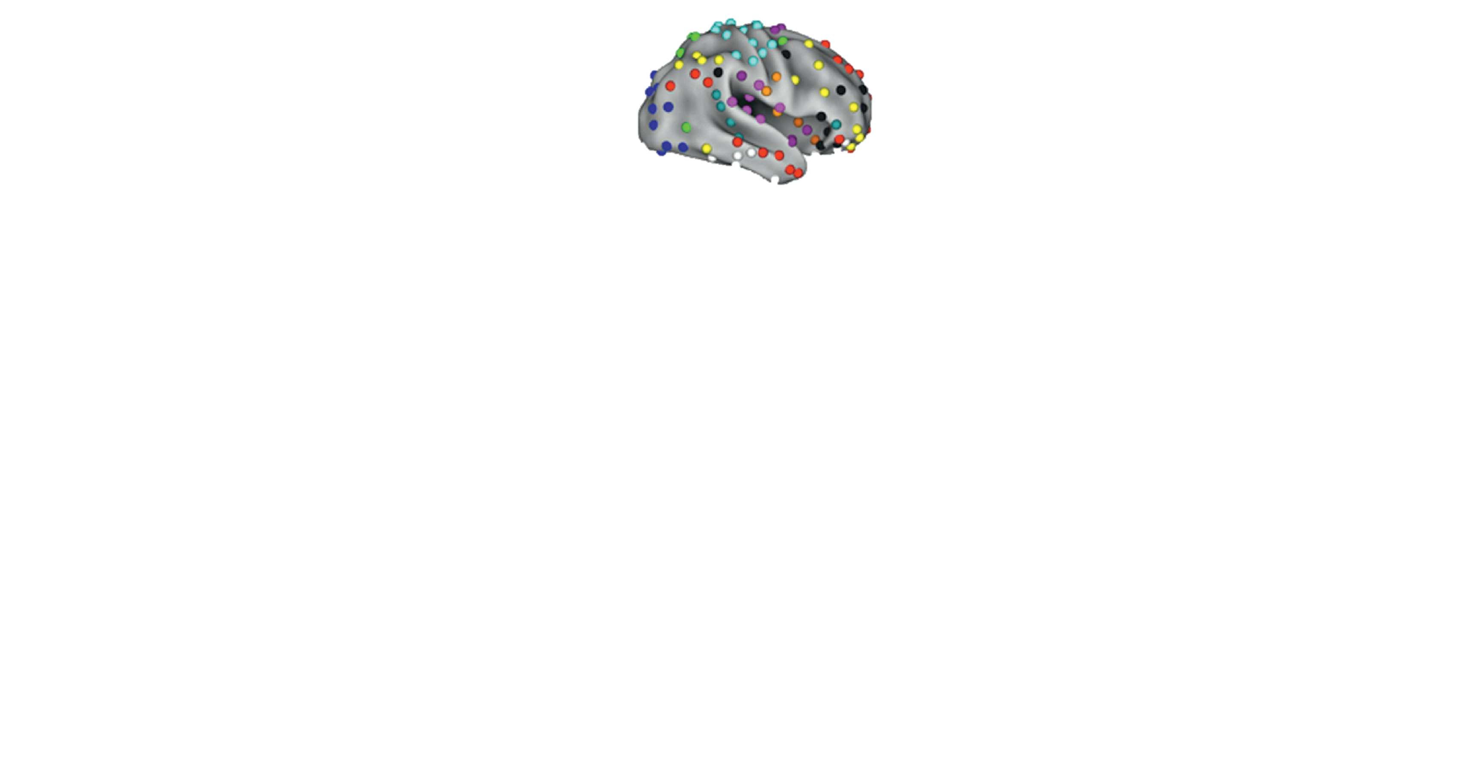
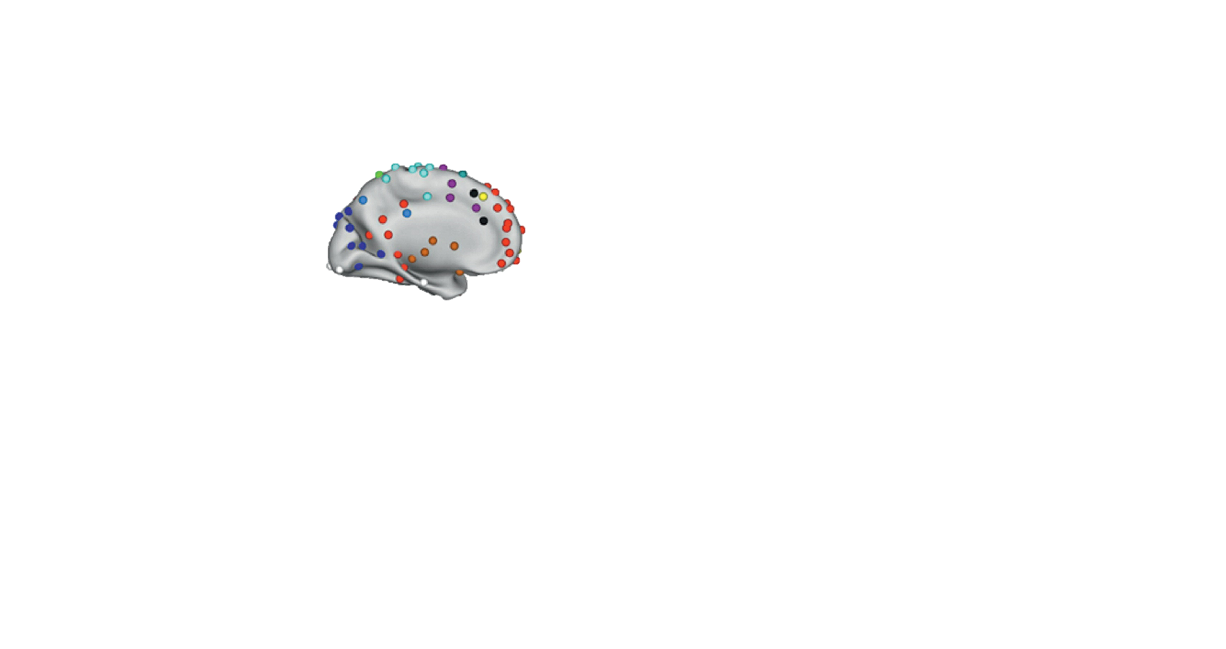
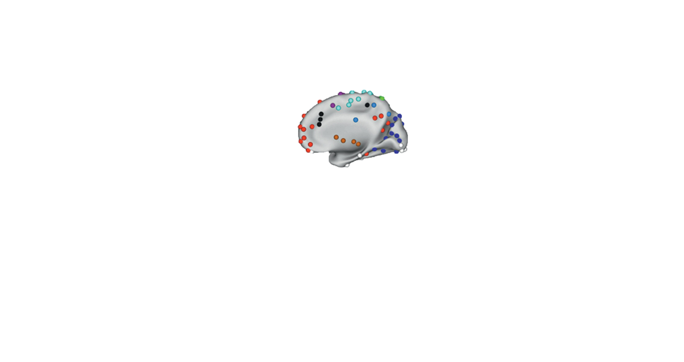
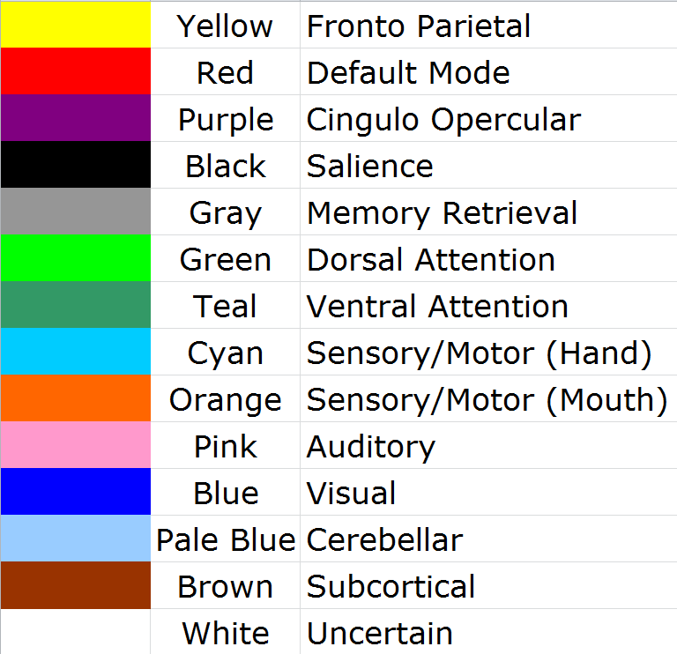
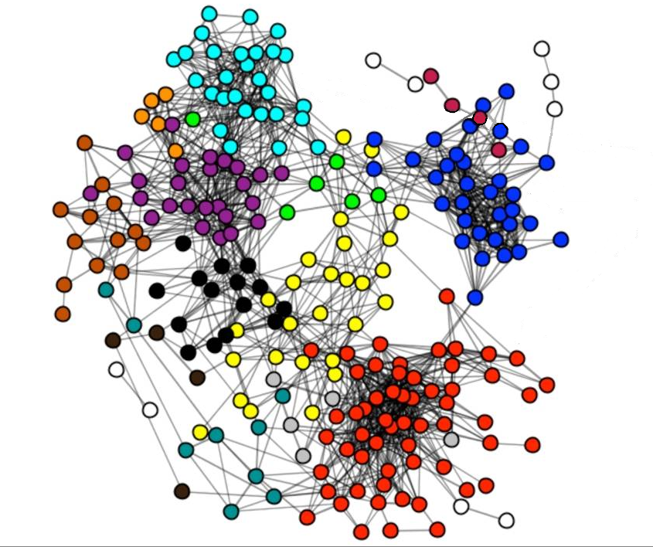
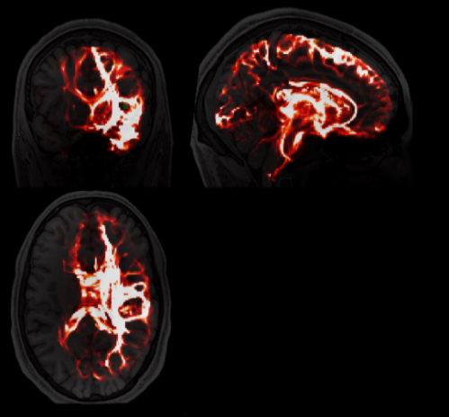
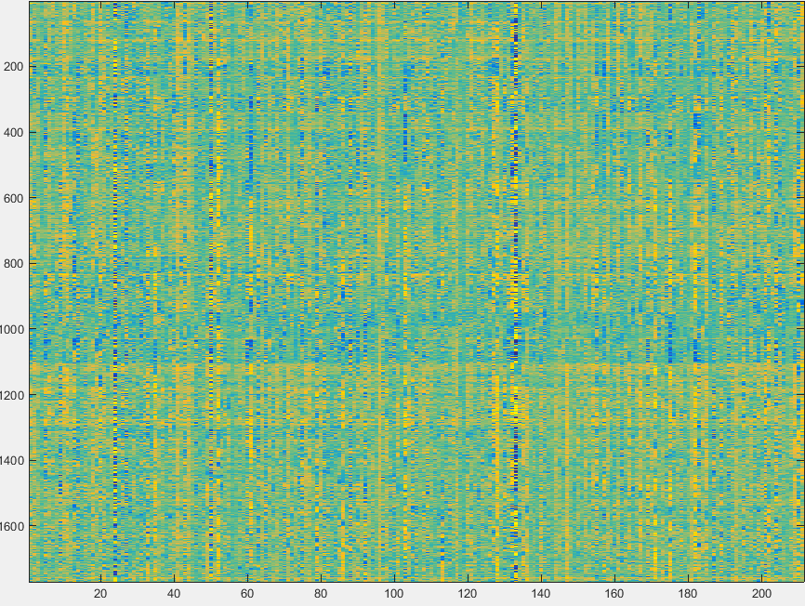
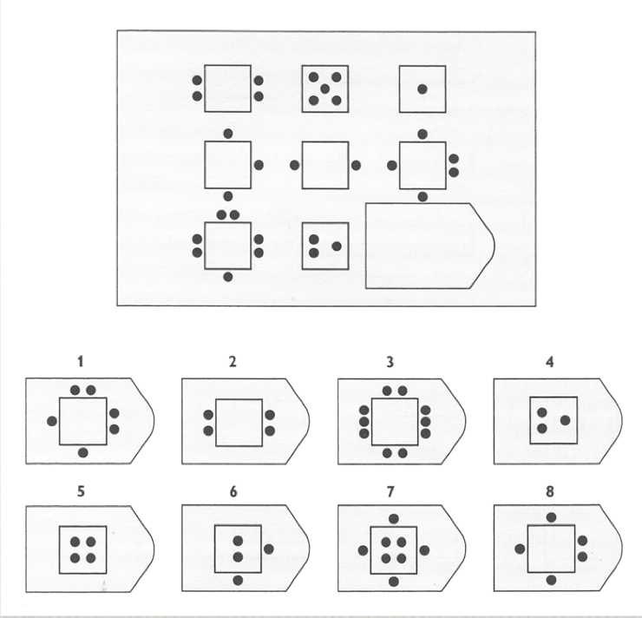

Neural Correlates of Fluid Intelligence
via Functional and Structural Network Connectivity Measures
Alvin Vuong^{1,2}, Nicco Reggente¹, Jesse Rissman^{1,3}
¹Department of Psychology, ²Department of Computer Science, ³Department of Psychiatry & Biobehavioral Sciences, University of California, Los Angeles
sf
Methods
Introduction
Results
Connectivity across regions in the brain can be characterized as either functional (FC; correlated fluctuations in activity as measured by resting-state fMRI data, rfMRI) or structural (SC; white matter pathways as measured by diffusion tensor MRI data, dMRI).¹
Emerging studies suggest that the connections across brain regions that make up distinct cognitive networks can partially explain individual differences in behavioral traits.^{2,4,5}
One benchmark of intelligence is the domain-invariant ability to identify subtle patterns across distantly related ideas; this is known as fluid intelligence (FI).^{1,4,5}
The Fronto-Parietal Network (FPN), Cingulo-Opercular Network (CON) and Default-Mode Network (DMN) have been shown to be associated with aspects of higher-order, domain-general cognitive functions.⁶⁻⁸
Specifically, both the FPN and CON have been shown to negatively regulate activity in the DMN.⁷ Therefore, the inter-network connectivity between these networks may be of significance.
Extending previous research⁸, we hypothesize that the SC and FC of the interactions between the FPN, CON, and DMN can be predictive of a person’s intelligence.
Here, we train a support vector regression model using data provided by the Human Connectome Project ^{10*} (HCP) to assess the degree to which the combined inter/intra-network FC and SC of individuals’ FPN, CON, and DMN might account for variance in fluid intelligence scores.
Behavioral, rfMRI, and dMRI data for 127 subjects were obtained from the HCP^{10*}.
Used the Petersen⁹ 14-network parcellation atlas for masking 264 regions-of-interest (ROIs) over all of the MR images.
rfMRI: (1200-frame time series; TR=720ms; TE=33.1ms; Slices=72)
dMRI: (288 directions; b₀=0; b={1000,2000,3000 s/mm² interspersed};
TR=5520ms; TE=89.5ms; Slices=111)
Constructed pairwise ROI FC and SC matrices.
With these FC & SC matrices, we can build network-based feature sets, to be used in a support vector regression (SVR) with a leave-1-subject-out cross-validation procedure as our predictive model.
Two ways in which we altered how we built the feature sets:
Able to assess the percentage of variance in fluid intelligence accounted for by a network’s or a pair of network’s subset of FC and SC values.
Note: We included a congregate network combining Salience with CON. We denote this as “S & CON”.
By correlating the array of predicted PMAT scores with the matched array of subjects’ actual PMAT scores, we were able to obtain an R² value – the percent of the variance in FI that our model was able to account for.
The model’s success was selective to the inter/intra-network connectivity between the DMN and S & CON, most notably when looking at the mono-directional SC, upper 50% SC mask over FC, and multiplied FC & SC.
***
**
*
Calculated the mean time course for each voxel in the each of the ROIs using MATLAB’s SPM package.
*
*
*
Eddy-corrected & processed with FMRIB’s Diffusion Toolkit (flirt, bedpostx, probtrackx) to yield whole-brain probabilistic tractography maps.
* < 0.05 ** < 0.005 *** < 0.00005
Conclusions
The CON has been shown to be a domain-general, task-control network,⁶ while the DMN has been shown to be the opposite, whose decreased activity associates with task control.³ It has also been shown that the CON might actually be involved in causally inhibiting the DMN during tasks.⁷
Our results support the hypothesis that the structural and functional connectivity between the CON and the DMN can at least partially explain an individual’s ability to perform a complex pattern completion task such as the PMAT.
While network connectivity metrics within a single network didn’t show much predictive power, inter/intra-network connectivity .
Structural integrity of a network can reflect the ability of which an individual can utilize that network.
Therefore, the structure and function of these networks, we’re able to see both how well the region’s wired up and how well they’re using it.
Perhaps, what our results are picking up is the efficiency of the CON’s ability to inhibit the DMN, so that a subject is not distracted by any internally generated narrative that could distract them from a task.
The functional connectivity across these networks, (during resting state), isn’t interesting. Task-state fMRI might be a better predictor. Presumably, we can hypothesize that the neural cascade of the CON to the DMN can explain the predictive power of the multiplied FC & SC between the two networks.
Interestingly, our results also seem to show that incorporating both FC and SC in a predictive model such as an SVR can be more or just as predictive than FC or SC alone.
Intra- vs. Inter-Network Connectivity
SC vs. FC
Example Feature Set For N = 127 Subjects:
FC only w/in the DMN (wX_f)
Within a single network (wX)
Across bi-directional two networks (amXY)
Across mono-directional two networks (aoXY)
sf
Cognitive Task Paradigm
Raven’s Progressive Matrices
Structural or Functional Only (s or f)
50% Structural Mask over Functional (smof_u, smof_l)
50% Functional Mask over Structural (fmos_u, fmos_l)
Multiplied Structural and Functional (interact)
References
Behavioral measure of FI is assessed using the Penn Progressive Matrices (PMAT) test (a shortened equivalent of Raven’s).
Subject must select 1 correct pattern out of the possible response patterns that best fits the missing square.
Pattern completion task consists of 24 items, and 3 bonus items, arranged in order of increasing difficulty.
Colom, R. et al. (2010). Human intelligence and brain networks. Dialogues in Clinical Neuroscience, 12(4), 489-501.
Dubois, J. and Adolphs, R. (2016). Building a science of individual differences from fMRI. Trends in Cognitive Sciences, n. pag.
Basten, U. et al. (2013). Intelligence is differentially related to neural effort in the task-positive and the task-negative brain network. Intelligence, 41.5, 517-528.
Ohtani, Toshiyuki et al. (2014). Medial frontal white and gray matter contributions to general intelligence. PLoS ONE, 9.12, e112691.
Malpas, Charles B. et al. (2016). MRI correlates of general intelligence in neurotypical adults. Journal of Clinical Neuroscience, 24, 128-134.
Dosenbach, N. U. F. et al. (2007). Distinct brain networks for adaptive and stable task control in humans. Proceedings of the National Academy of Sciences, 104.26, 11073-11078.
Chen, A. C. et al. (2013). Causal interactions between fronto-parietal central executive and default-mode networks in humans. Proceedings of the National Academy of Sciences, 110.49, 19944-19949.
Cornali, C., Reggente, N., Rissman, J. (2015). The predictive power of functional network connectivity in cognitive function. Poster session presented at: Psychology Undergraduate Research Conference; 2015 May 8; Los Angeles, CA.
Power, J. D. et al. (2011). Functional network organization of the human brain. Neuron, 72.4, 665-678.
Van Essen, D.C., et al. (2013). The WU-Minn Human Connectome Project: An overview. NeuroImage, 80, 62-79.
Examined the correlation of the model’s assigned scores with each subject’s actual PMAT scores.
*Data were generously provided by the Human Connectome Project (Q3 release), WU-Minn Consortium (PIs: David Van Essen &
Kamil Ugurbil; 1U54MH091657) funded by the 16 NIH Institutes and Centers that support the NIH Blueprint for Neuroscience
Research; and by the McDonnell Center for Systems Neuroscience at Washington University
Contact: Alvin Vuong <alvin.t.vuong@ucla.edu>, http://rissmanlab.psych.ucla.edu
Notes:
SPM – Statistical Parametric Mapping (analysis of brain imaging data sequences, like time series data)
FMRIB – Oxford Centre for the fMRI of the Brain
FLIRT – FMRIB‘s Linear Image Registration Tool
BEDPOSTX – Bayesian Estimation of Diffusion Parameters Obtained using Sampling Techniques (X stands for modelling Crossing Fibres)
P-FIT – Parietal-Frontal Integration Theory of Intelligence
58 Nodes in DMN = 58*57/2 total relevant ROI pairings (n*(n-1)/2)

